Slide 1
Genetic painting
Koki Yamanaka

Slide 2

Art – Eiffel Tower

Slide 3
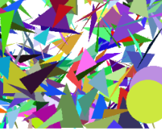
Method
We used a genetic algorithm model
Gene : Each shapes specifies the x-y coordinates, colors, size.
Chromosome : candidate images with a set of circles and triangles
Fitness (MSE) to evaluate the similarity between candidate and target

Slide 4
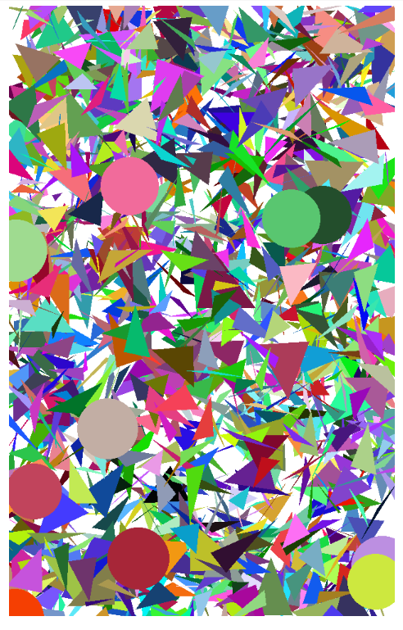
Results
Too many parameters, difficult to fine tuning
Hard to understand the underlying mechanism

Slide 5

Simpler version

Slide 6
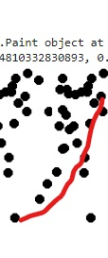

Method – simpler version
Each candidate image works a set of circles
Each circles specifies only x-y coordinates on the image.

Slide 7
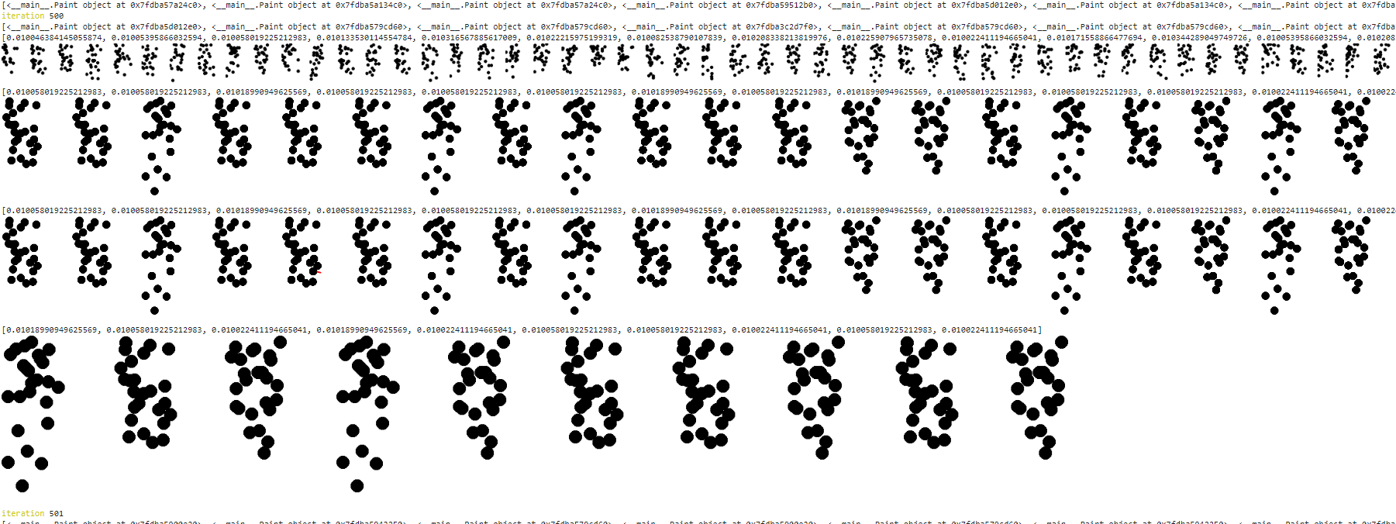
Method
Generate a list of images
Tournament : Select a subset of images
Mutate : shift the position of each circles
Crossover : for each images, swap their x-y coordinates

Slide 8
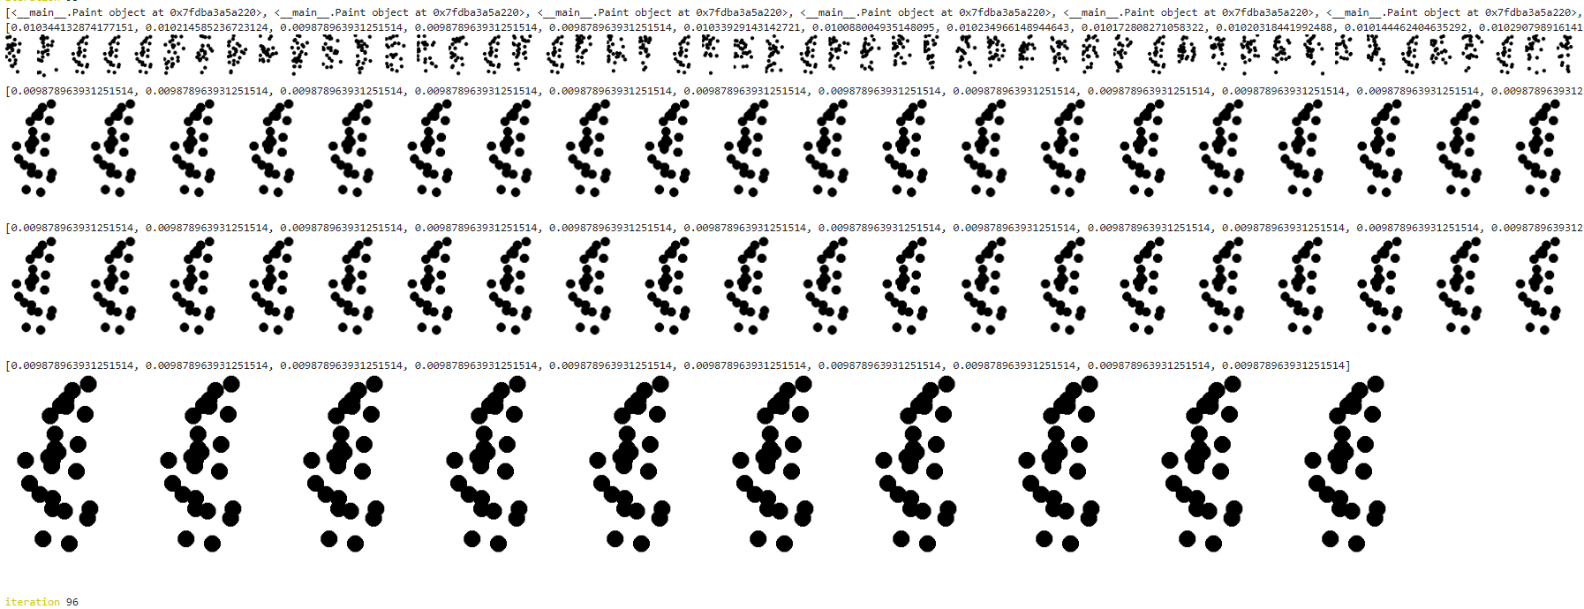
Gallery – stuck at local optima

Slide 9

Results
Still need fixing

Slide 10
Next Steps
Experiment each parameters effect more thoroughly
Visualize the effect of parameters at each phase (mutation, crossovers,..)
Try a different fitness function
Circle Point distance : minimize the distance between circles position and the black points that represent the outline of the tower.
We add a penalty when circle distributed too much in 1 area.

Slide 11
Lesson learned
Build a small scale genetic model, then gradually build up to a complex ones.

Slide 12
Thank you for listening !

